Slide 1

Yala Safari Camping
Sri lanka

Slide 2
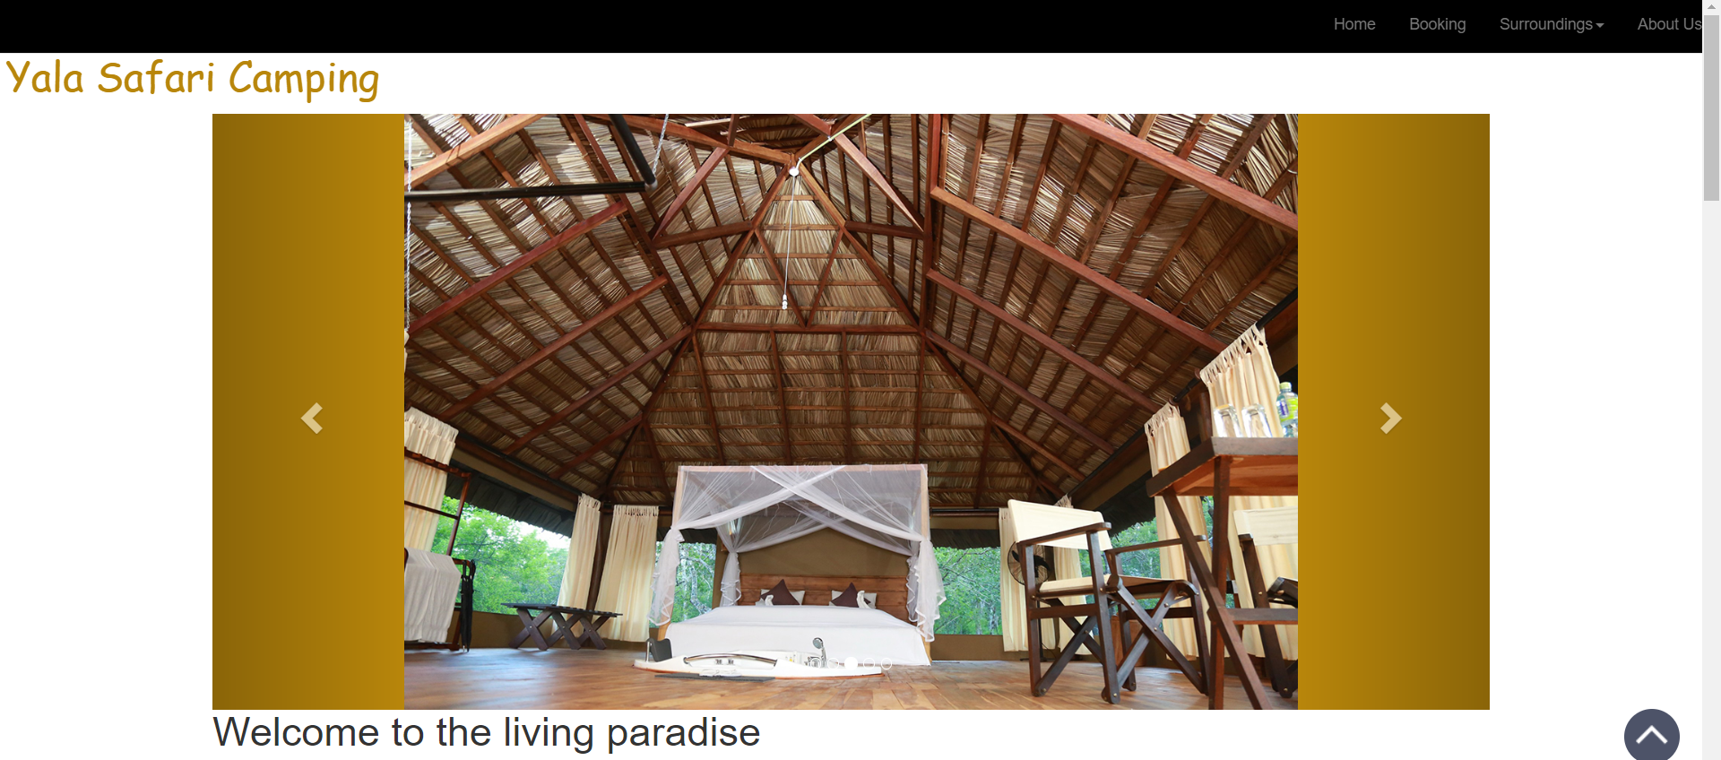
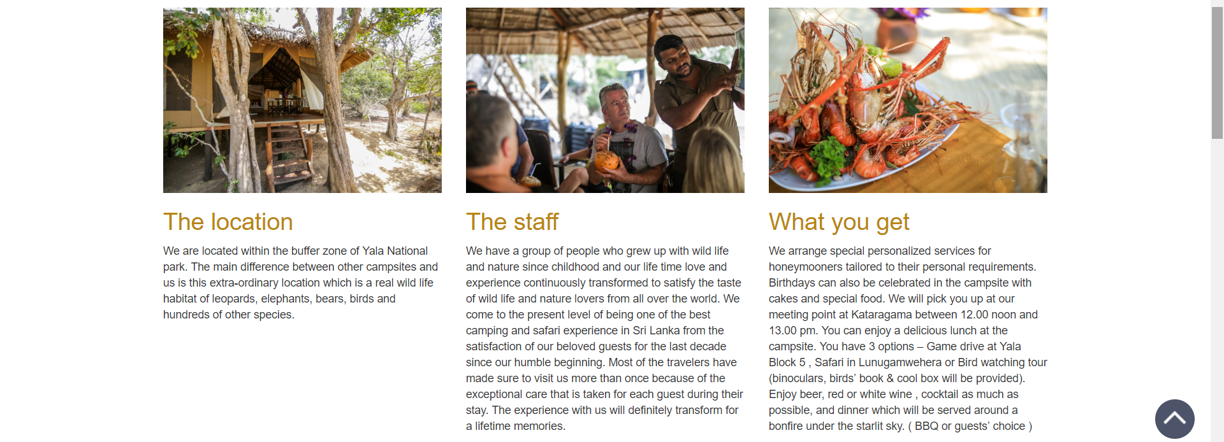

Slide 4
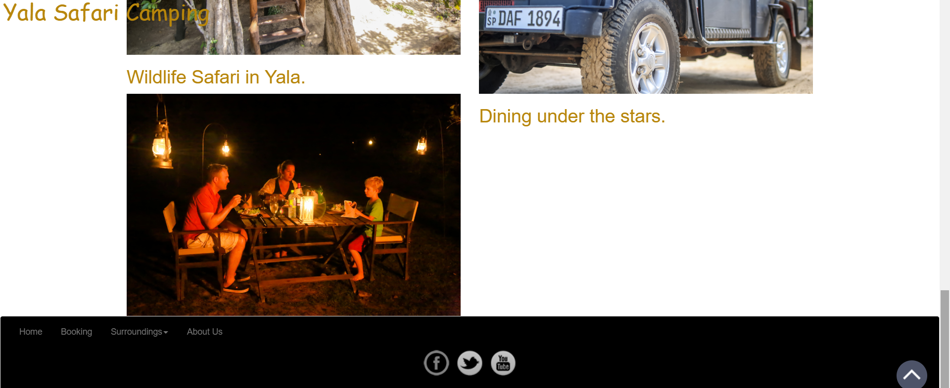

Slide 5
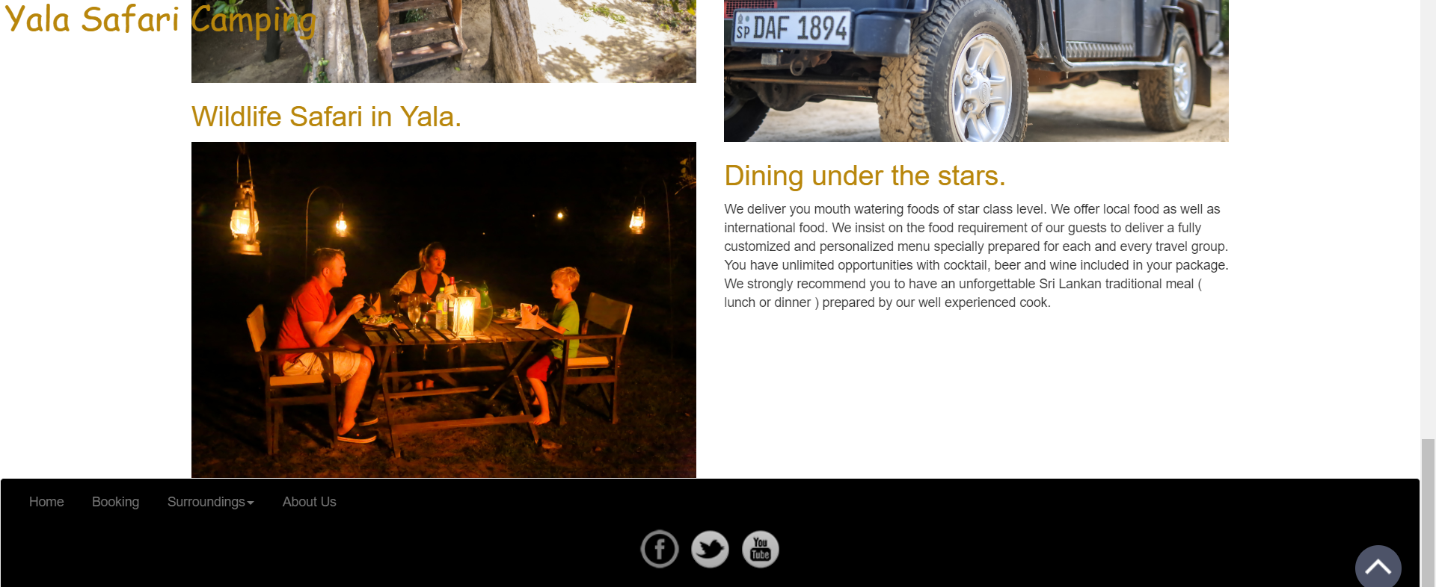

Slide 6
Two Content Layout with Table
Class | Group A | Group B
Class 1 | 82 | 85
Class 2 | 76 | 88
Class 3 | 84 | 90
First bullet point here
Second bullet point here
Third bullet point here

Slide 7
Two Content Layout with SmartArt
First bullet point here
Second bullet point here
Third bullet point here
Group A
Task 1
Task 2
Group B
Task 1
Task 2
Group C
Task 1

